Slide 1
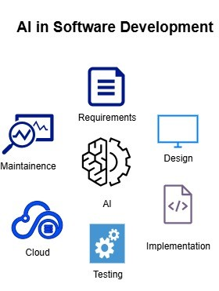
Cloud-Enabled AI Framework for SDLC Optimization
A systematic review of AI-powered frameworks for optimizing software development lifecycle through cloud integration
Guide
Dr. M. Parthiban
Professor
Team Members
M. Hari Priyanka
B. Pavan Teja
T. Ratna Kumari
N. Subba Lakshmi

Slide 2
1
Gap Identified
2
Problem Statement
3
Aim &Objectives
Contents
4
Scope
5
Data Collection
6
Architecture Diagram
7
Block diagram , Data Flow Diagram
8
Algorithm / Model Development

Slide 3
Identifying Critical Gaps in SDLC Automation
Limited AI Integration
Most existing AI solutions address isolated SDLC phases (requirements, testing, or code) and lack an integrated, end-to-end SDLC optimization pipeline..
Insufficient Traceability
Automated traceability across requirements, design, implementation, and testing is largely absent, leading to poor impact analysis and maintainability.
Contextual Understanding
Existing NLP and LLM-based approaches struggle to achieve deep contextual understanding of SRS documents, often producing ambiguous or hallucinated outputs.
Security & Ethics
Security, explainability, ethical AI usage, and accountability are insufficiently addressed in current AI-based SDLC solutions, limiting real-world adoption.

Slide 4
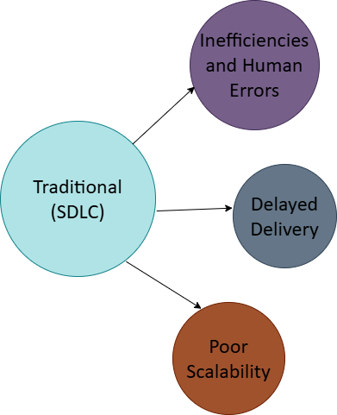
Problem Statement
Traditional Software Development Life Cycle (SDLC) models are often burdened by manual processes. This reliance leads to significant challenges:
Inefficiencies and Human Errors: Manual interventions introduce delays and increase the likelihood of mistakes.
Delayed Delivery: Slower processes directly impact time-to-market for critical software.
Poor Scalability: Manual methods struggle to adapt to growing project complexity and demand.
Example: In an online banking application, ambiguous requirements documented in the SRS may be misinterpreted during design, causing coding errors that surface only during testing and lead to rework and delays. Security checks performed late in deployment further increase vulnerability risks. A cloud-based AI-driven SDLC framework can automatically interpret requirements, generate accurate designs, assist in code development, perform continuous testing, and enforce security throughout the lifecycle, thereby reducing defect rate, time, and risk.

Slide 5
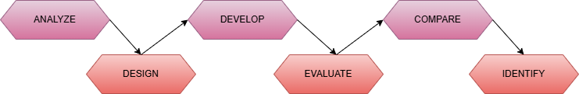
Aim & Objectives
Aim :-
To design and rigorously analyze a cloud-based AI-driven SDLC optimization framework that comprehensively enhances efficiency, scalability, quality, and security across all phases of software development.
Key Objectives :-
To study and analyze existing AI and cloud-based SDLC frameworks and identify their limitations.
• To design a unified AI-driven SDLC architecture integrating requirement analysis, defect prediction, testing, and deployment.
• To develop AI-assisted modules for requirement engineering, design generation, defect prediction, and testing using ML and RAG-based models.
• To evaluate the performance of the proposed framework using standard metrics such as accuracy, precision, recall, and F1-score.
• To compare traditional SDLC approaches with AI-enabled SDLC models to highlight improvements in automation and quality.
• To identify research gaps and propose future enhancements for continuous SDLC optimization.

Slide 6
Scope
What is Included : Core AI-SDLC Innovations
AI-assisted requirement analysis: Utilizing NLP and LLMs for precise extraction.
Automated design and UML generation: Accelerating the architectural phase.
Generative AI-assistant code generation: Creating efficient and robust code.
AI-driven testing and quality assurance: Ensuring high-quality software.
Cloud-based deployment and DevSecOps integration: Streamlining operations.
Predictive risk management and monitoring: Proactive identification of issues.
Integration of RAG-based AI and hybrid ML models for SDLC optimization across multiple phases
What is Excluded: Boundaries for Focus
Full industrial-scale implementation: Focusing on design and analysis, not large-scale deployment.
Real-time production deployment: Not covering live operational scenarios.
Proprietary datasets and closed-source AI tools: Limiting to publicly available resources.
Legal and organizational policy enforcement: Beyond the technical framework's direct scope.

Slide 7
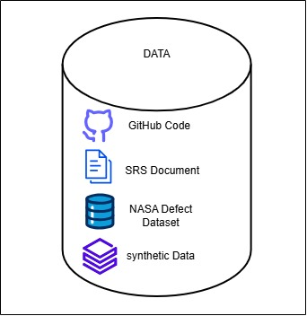
Data Collection
Dataset Name :
Hybrid SDLC Dataset (SRS + GitHub Code + NASA Defect Dataset)
Category :
Public DatasetCustom Dataset (Project-Specific)
Source :
Software Requirement Specification (SRS) documents (PDF format)Open-source software repositories from GitHubNASA MDP Software Defect Dataset (KC1)
Description :
The experimental dataset consists of SDLC artifacts, including SRS documents, open-source GitHub project code, and the NASA MDP KC1 dataset for defect prediction. Synthetic variations are used to simulate real-world project evolution. This hybrid dataset supports evaluation of the proposed cloud-enabled, RAG-based AI framework across multiple SDLC phases.

Slide 8
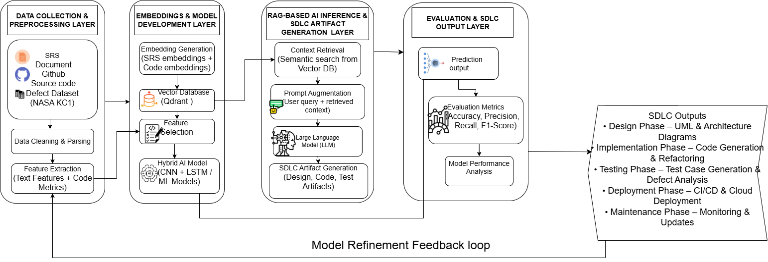
Architecture

Slide 9
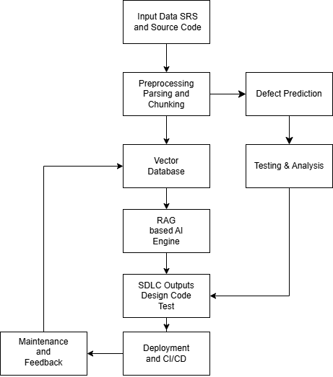
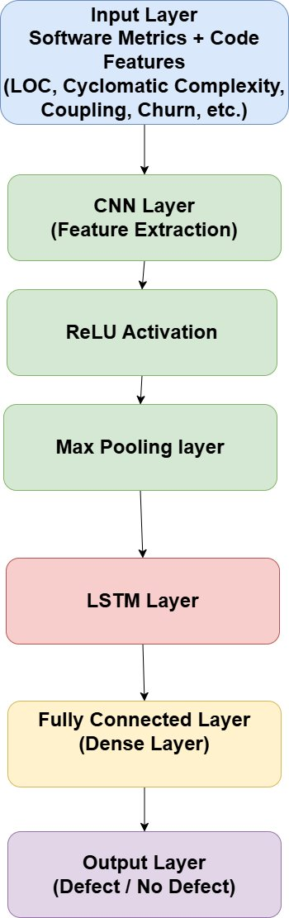
Block Diagram
Neural Network ​

Slide 10
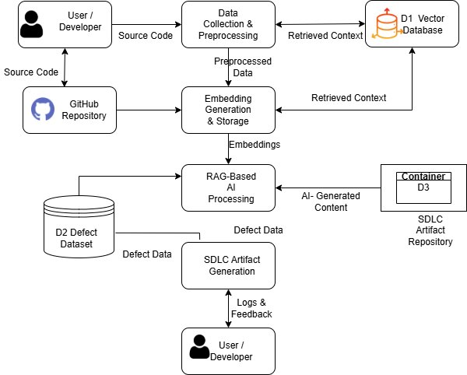
Data Flow Diagram​

Slide 11
Algorithm / Model Development Workflow
Input: SRS documents, GitHub source code, NASA KC1 defect dataset, user query
Algorithm Steps:
Data Preprocessing: Clean and parse SRS text, extract source code metrics (LOC, complexity, coupling), and normalize features.
Feature & Embedding Generation: Generate text embeddings for SRS and code embeddings for source code; store them in a vector database for semantic retrieval.
Defect Prediction (Hybrid ML Model): Apply a CNN to learn structural patterns from software metrics and an LSTM to capture dependency behavior across modules, producing defect probability scores.
RAG-Based Inference: Retrieve relevant project context from the vector database and augment prompts for the Large Language Model (LLM).
SDLC Artifact Generation: Generate design diagrams, code suggestions, and test cases using the grounded LLM outputs.
Evaluation & Feedback: Evaluate model performance using Accuracy, Precision, Recall, and F1-Score; update embeddings and models through a continuous feedback loop.
Output: Optimized SDLC artifacts, defect predictions, and performance metrics.

Slide 12
THANK YOU

